Slide 1
Capstone Project - The Battle of Neighborhoods (Week 2)
One slider - Summary
Business Introduction
Data
Methodology
Analysis
Results
Conclusion

Slide 2
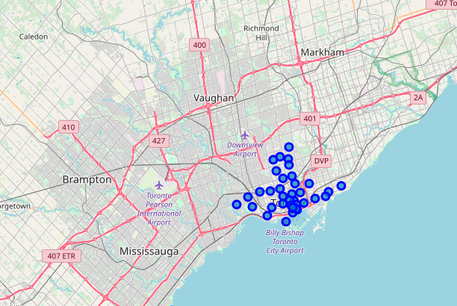
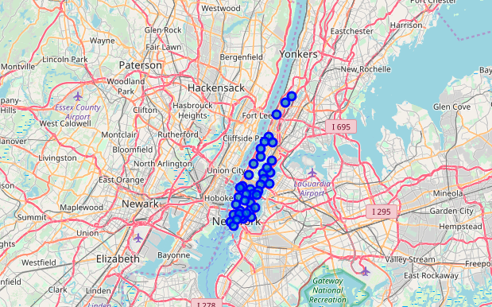
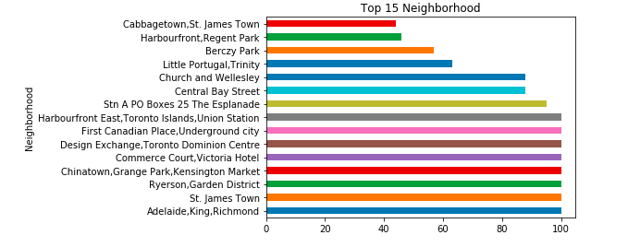
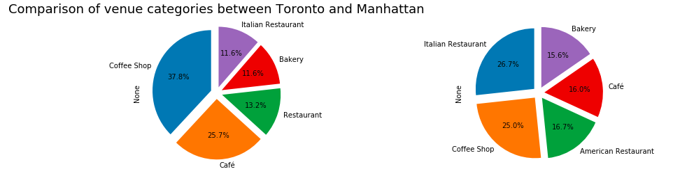
One slider - Summary
Problem Statement/Background
Data Analysis
To understand if both the cities - Toronto and Manhattan are similar or dissimilar
We have lots of details available in terms of venues and its categories, let us see how can we apply the analytical skills to test the hypothesis
In this project, we are limiting the number of venues by 100 returned by Foursquare API and radius = 500
Data Requirement
The following datasets are used in this project:
Toronto dataset - Dataset with details about Neighborhood, latitude, longitude and corresponding venue details
Manhattan dataset - Dataset with details about Neighborhood, latitude, longitude and corresponding venue details
Geospatial data - Dataset with details about postal code, latitude and longitude
Foursquare API - To retrieve the venues, its latitude and longitude
Geopy API - To get the coordinates of Toronto and Manhattan
Results

Slide 3

Business Introduction
Problem statement:
To understand if both the cities - Toronto and Manhattan are similar or dissimilar
We have lots of details available in terms of venues and its categories, let us see how can we apply the analytical skills to test the hypothesis
In this project, we are limiting the number of venues by 100 returned by Foursquare API and radius = 500

Slide 4
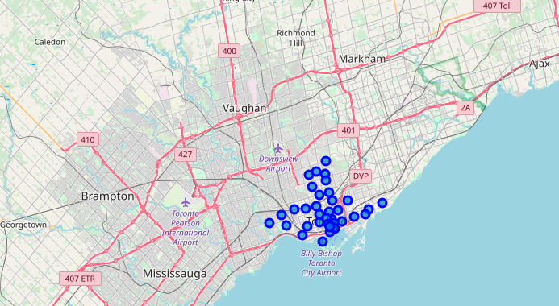
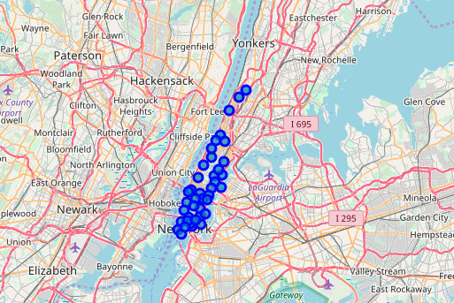
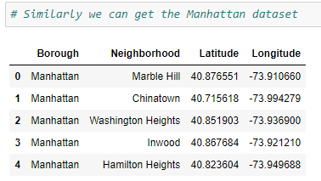
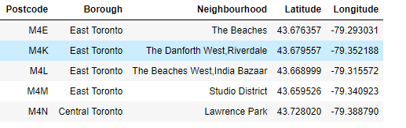
Data
The following datasets are used in this project:
Toronto dataset - Dataset with details about Neighborhood, latitude, longitude and corresponding venue details
Manhattan dataset - Dataset with details about Neighborhood, latitude, longitude and corresponding venue details
Geospatial data - Dataset with details about postal code, latitude and longitude
Foursquare API - To retrieve the venues, its latitude and longitude
Geopy API - To get the coordinates of Toronto and Manhattan
Map view of Toronto dataset
Map view of Manhattan dataset
Sample of Toronto dataset
Sample of Manhattan dataset

Slide 5
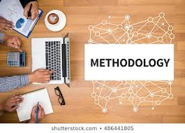
Methodology
It involves the following steps:
1. Data Loading and pre-processing
* Preprocessing the Neighborhood dataset and creating a subset for Toronto dataset
* Preprocessing the Manhattan dataset
* Generating the co-ordinates for both the neighborhoods
2. Analysis(Exploratory data analysis)
* Identification of top venues in both the cities
* Identification of top restaurants in both the cities
* Comparison of number of venues in both the neighborhoods
3. Results(Comparison between Toronto and Manhattan)

Slide 6
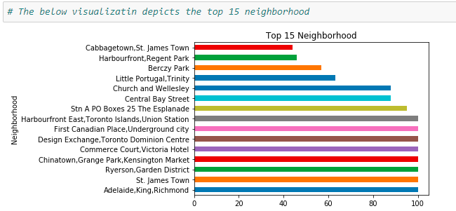
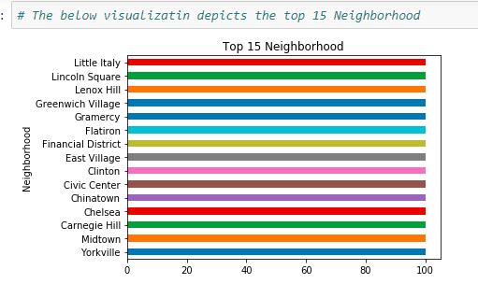
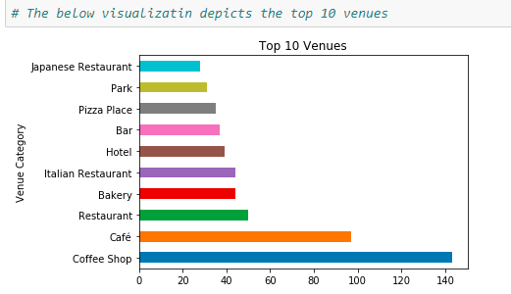
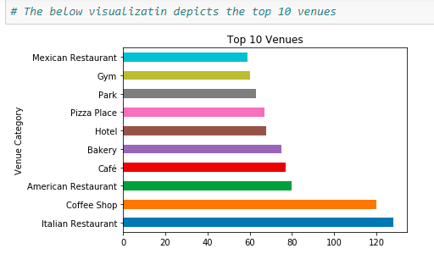
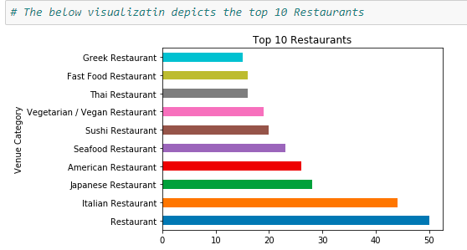
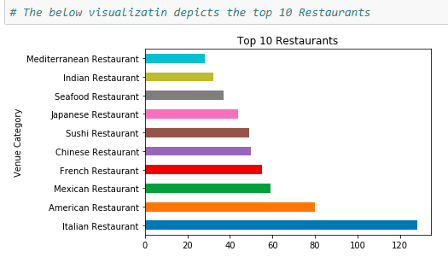
Analysis
The below charts belongs to Toronto
The below charts belongs to Manhattan
The top 15 neighborhoods
The top 10 venues
The top 10 restaurants

Slide 7
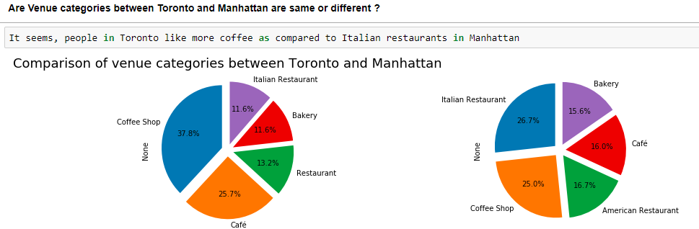
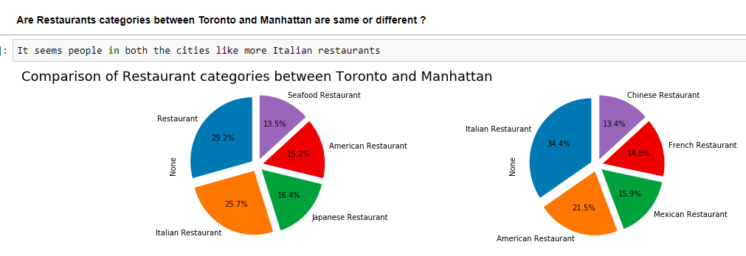
Results
We can clearly see, people in Toronto has more coffee shops whereas at Manhattan we have restaurants followed by coffee shops
Interestingly people in both the cities has more preference to Italian restaurants

Slide 8
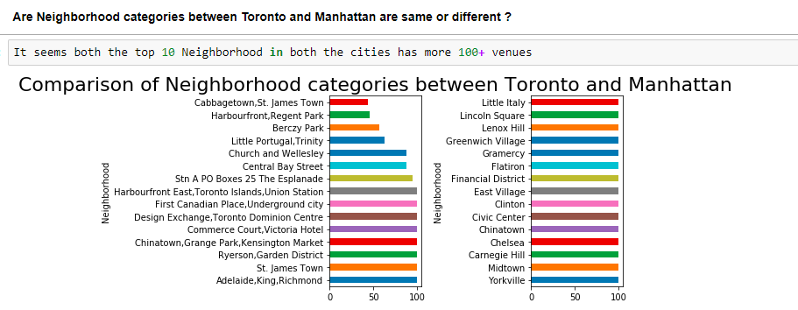
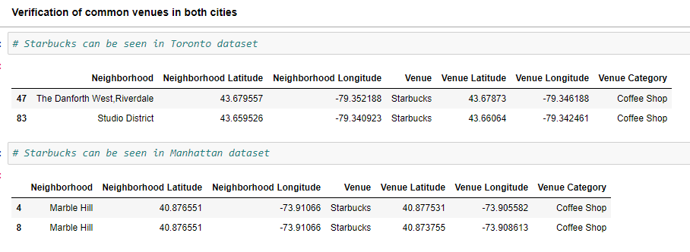
Results
Surprisingly, most of the neighborhoods in both the cities has 100+ venues offering
16 out of 108 venues are common in both the cities

Slide 9
Conclusion
Based on the analysis, the observations are as below:
It seems though number of Neighborhood are almost same in both the cities, Manhattan has more number of venues/venue categories
It seems, people in Toronto like more coffee as compared to Italian restaurants in Manhattan
It seems people in both the cities like more Italian restaurants
It seems both the top 10 Neighborhood in both the cities has more 100+ venues
16 venues are in common in both the cities
Based on observation, it seems both the cities share liking pattern wrt venues

